Slide 1
outline
IC asynchronous counters, Asynchronous down counter, Asynchronous up/down counter, Propagation delay in ripple counters, Synchronous counter, Synchronous down counter, Synchronous up/down counters, decoding a counter, Decoding glitches, Cascading BCD counters,
shift register. Counter applications: frequency counter, digital clock.
MSI (Medium scale integration) Logic Circuits: Decoders, BCD-to-decimal decoders, BCD to-7-segment decoder/drivers. Encoders, Multiplexers and multiplexer applications, Demultiplexers.

Slide 2
counters

Slide 3
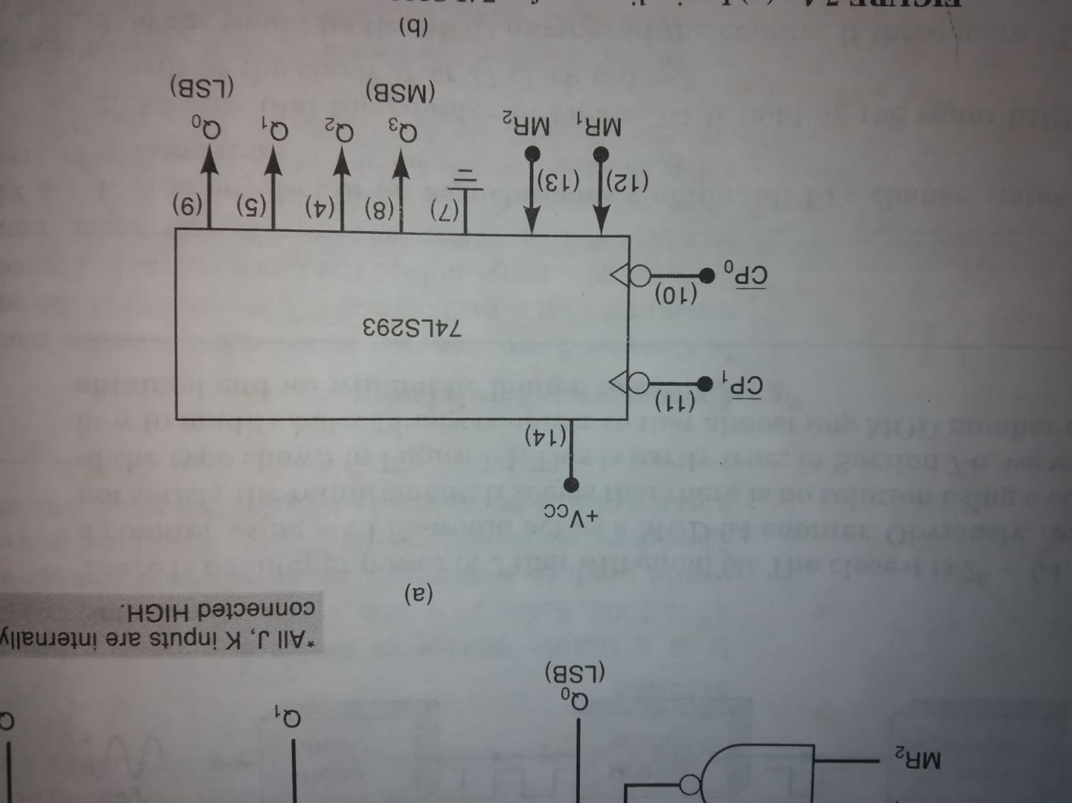
IC Asynchronous Counter 74LS293/74LS93

Slide 4
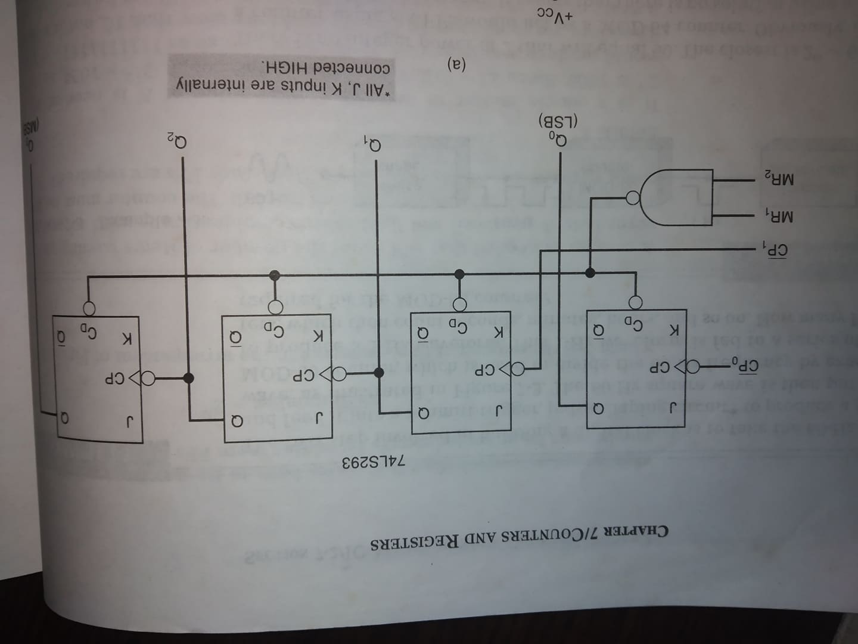
IC Asynchronous Counter

Slide 5
Construct a MOD-10/ 16 counter using 74ls293/ 74ls93 ic

Slide 6
Asynchronous ripple Counter Asynchronous UP counter

Slide 7
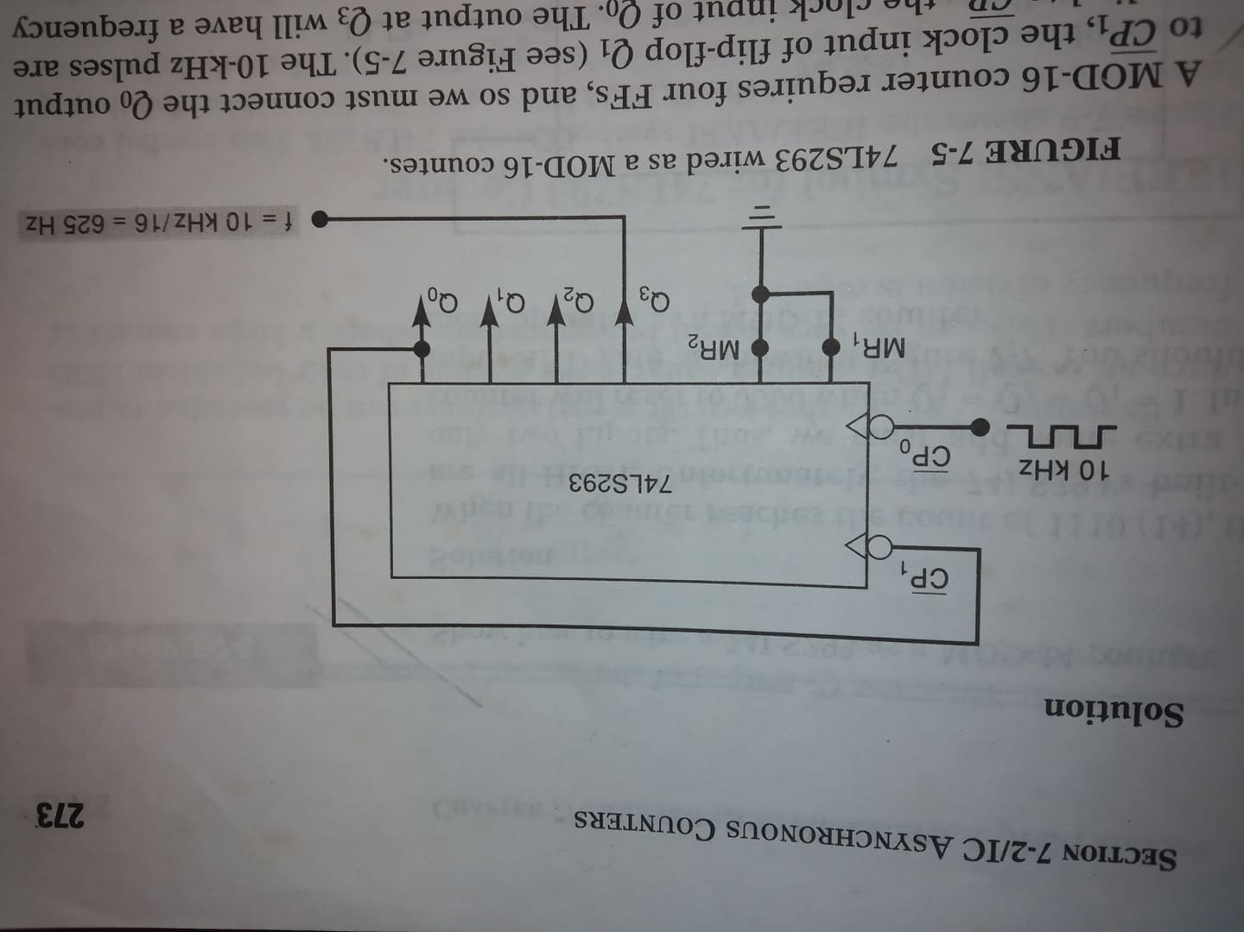
Construct a MOD-16 counter using 74ls293 ic

Slide 8
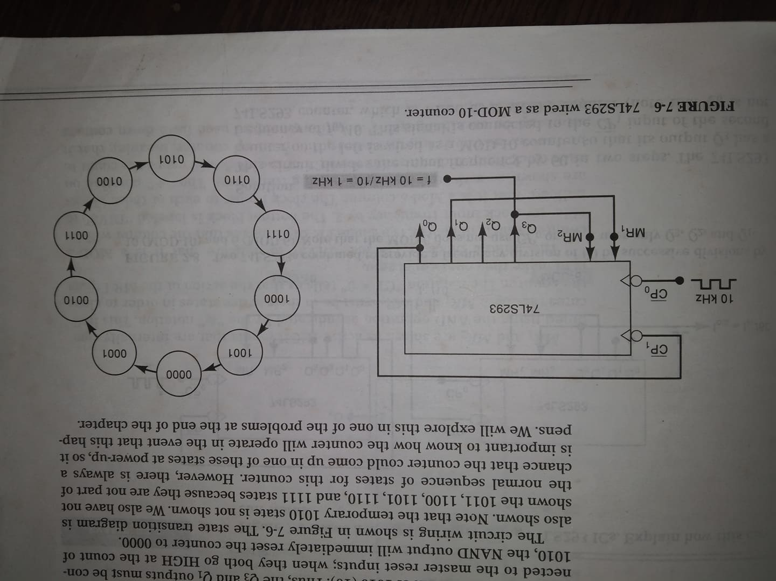
Construct a MOD-10 counter using 74ls293 ic

Slide 9
Construct a MOD-60 (6*10=60) counter using 74ls293/ 74ls93 ic

Slide 10
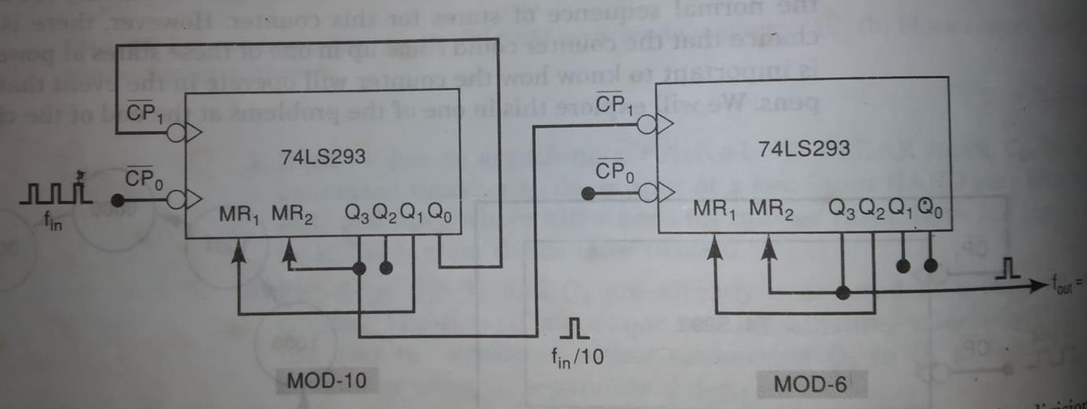
MOD-60 counter

Slide 11
Home work Circuit with mod no. <2^{N} (MOD-6 or Mod 5 or mod 3)

Slide 12
Asynchronous down counter

Slide 13
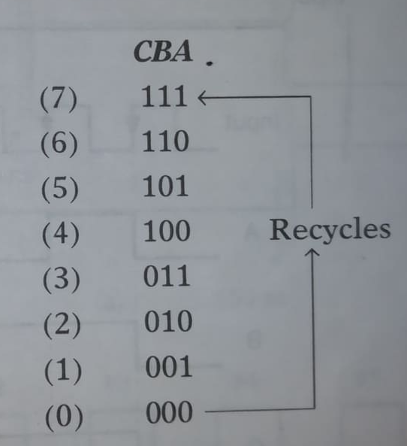
asynchronous (ripple) down counter

Slide 14
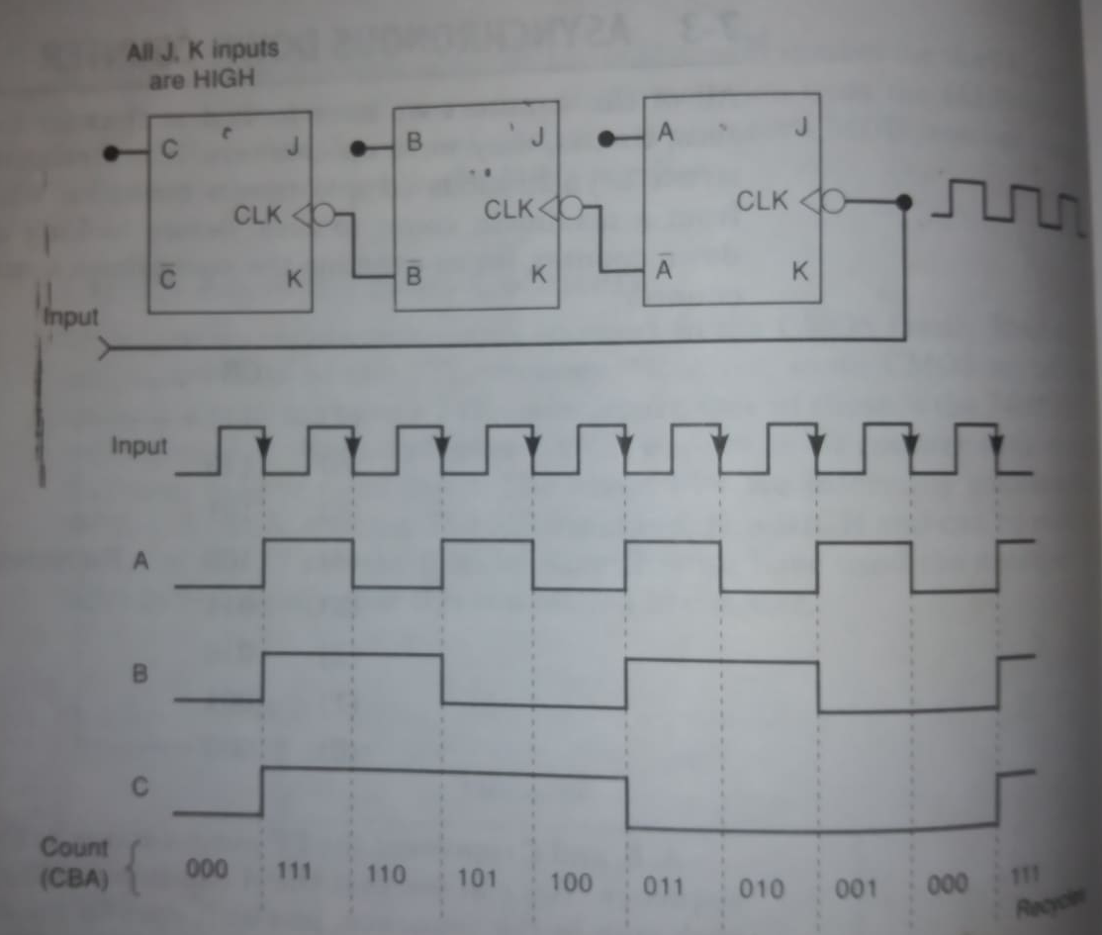
asynchronous (ripple) down counter

Slide 15
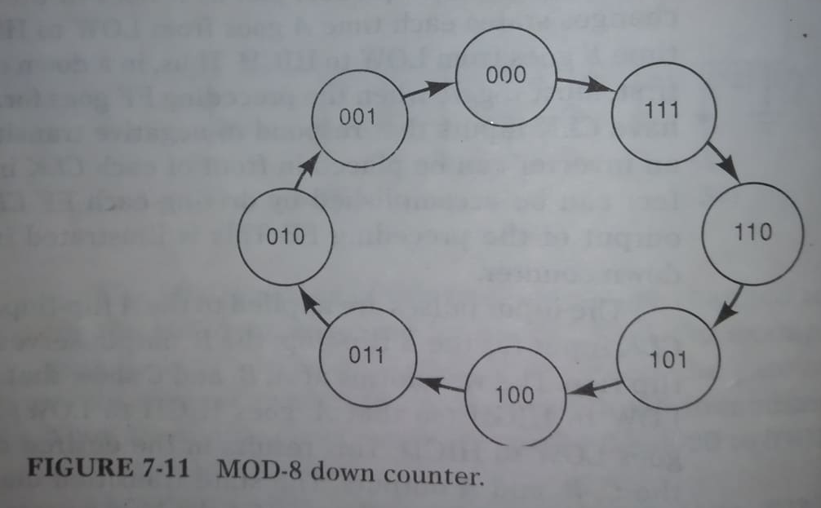
asynchronous (ripple) down counter

Slide 16
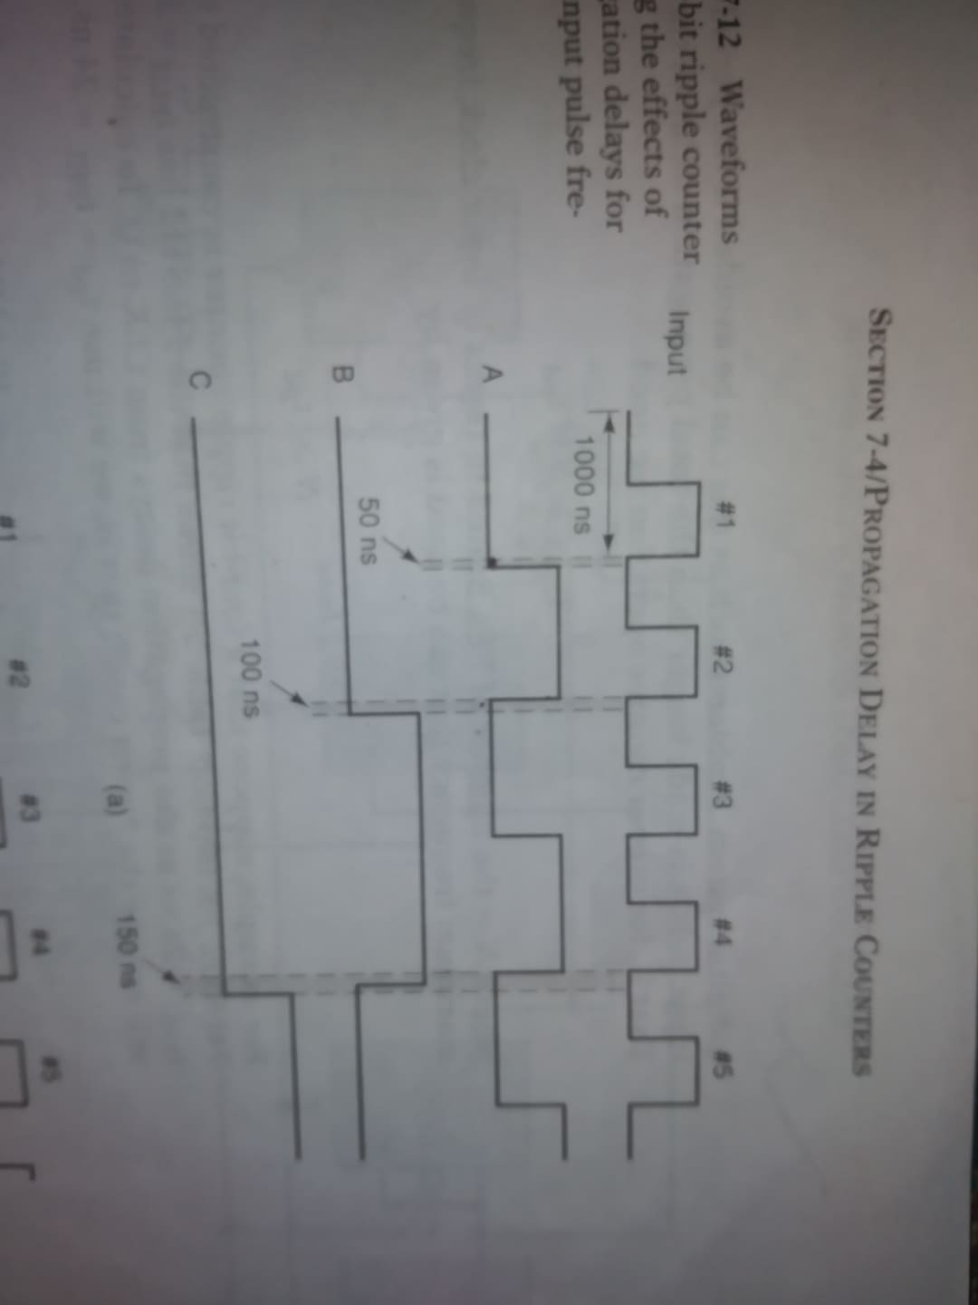
Propagation delay in ripple counters

Slide 17
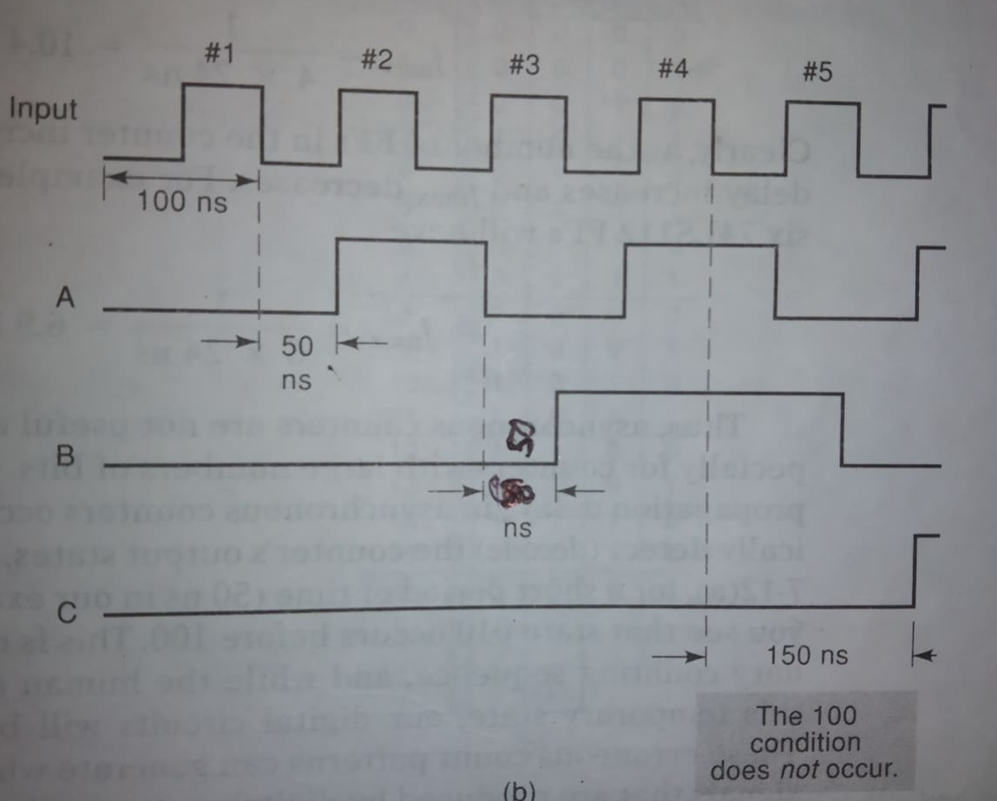
Propagation delay in ripple counters

Slide 18

Propagation delay in ripple counters
Propagation delay of single FF=t_{pd}
Propagation delay of two FF=2* t_{pd}
Propagation delay of N FF=N* t_{pd}
To overcome the problem, the clock pulse should be designed in such way where the pulses is made longer than the total propagation delay of the counter.
$T_{clock}≥N×t_{pd}$
$$f_{max}=\frac{1}{N×t_{pd}}$$
$f_{max}=\frac{1}{4×t_{pd}}$=10.4 MHz
$f_{max}=\frac{1}{6×t_{pd}}$ = 6.9 MHz

Slide 19
Synchronous (parallel) counters

Slide 20
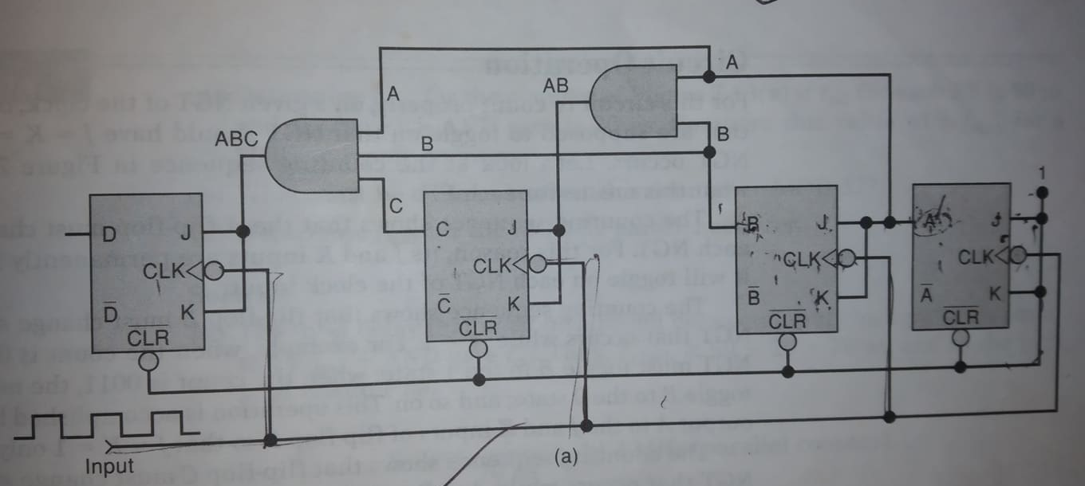
synchronous up counter

Slide 21
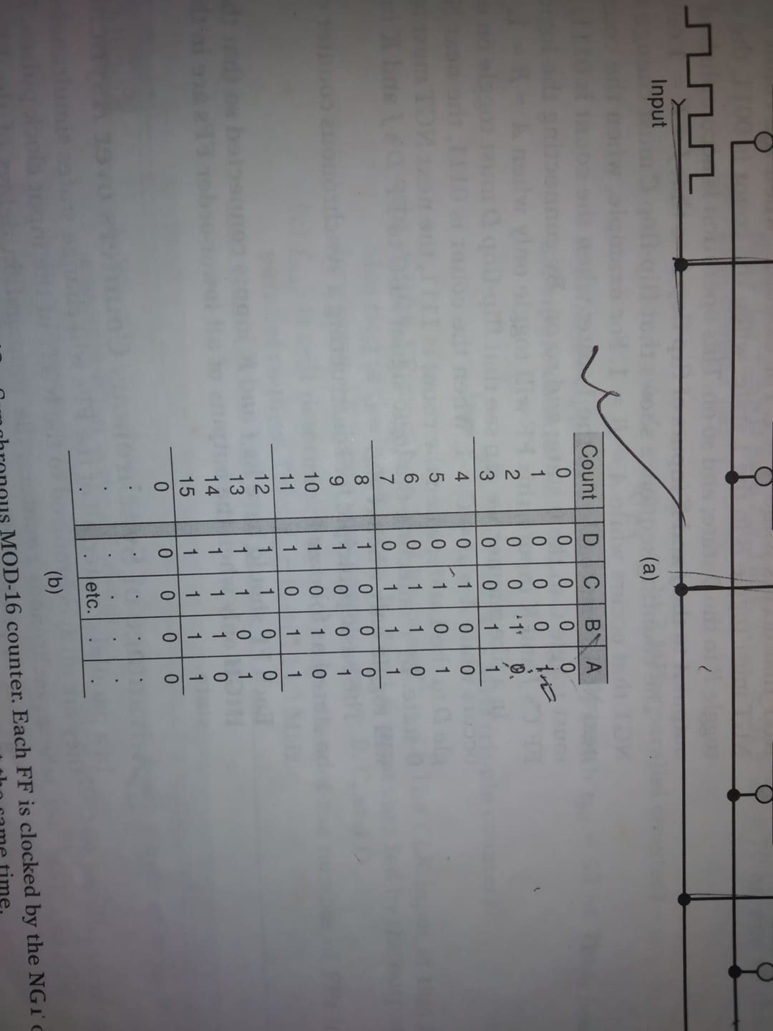
Synchronous (parallel) counters

Slide 22
Propagation delay in parallel counters
Total delay of parallel counter=${FF}_{t_{pd}}+AND gate t_{pd}$

Slide 23
Shift register counters

Slide 24
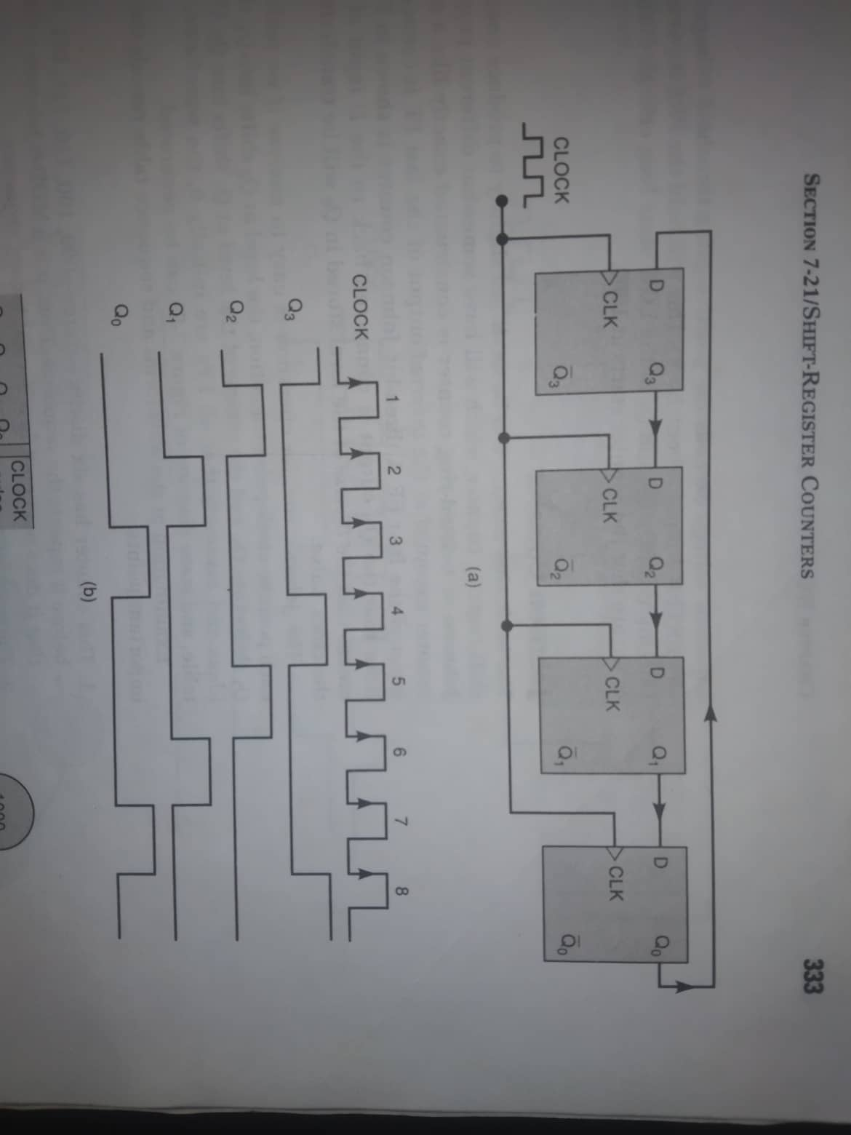
Ring counter

Slide 25
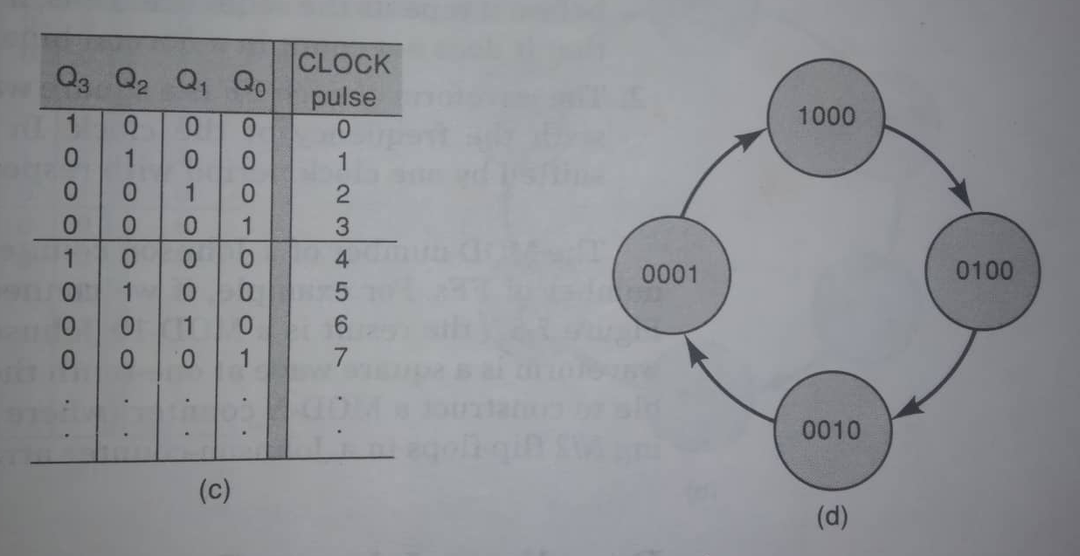
Ring counter

Slide 26
Decoding a counter

Slide 27
Decoding a counter
A decoding network is a logic circuit, that generates X different outputs, each of which detects/ decodes the presence of one particular state of the counter.

Slide 28
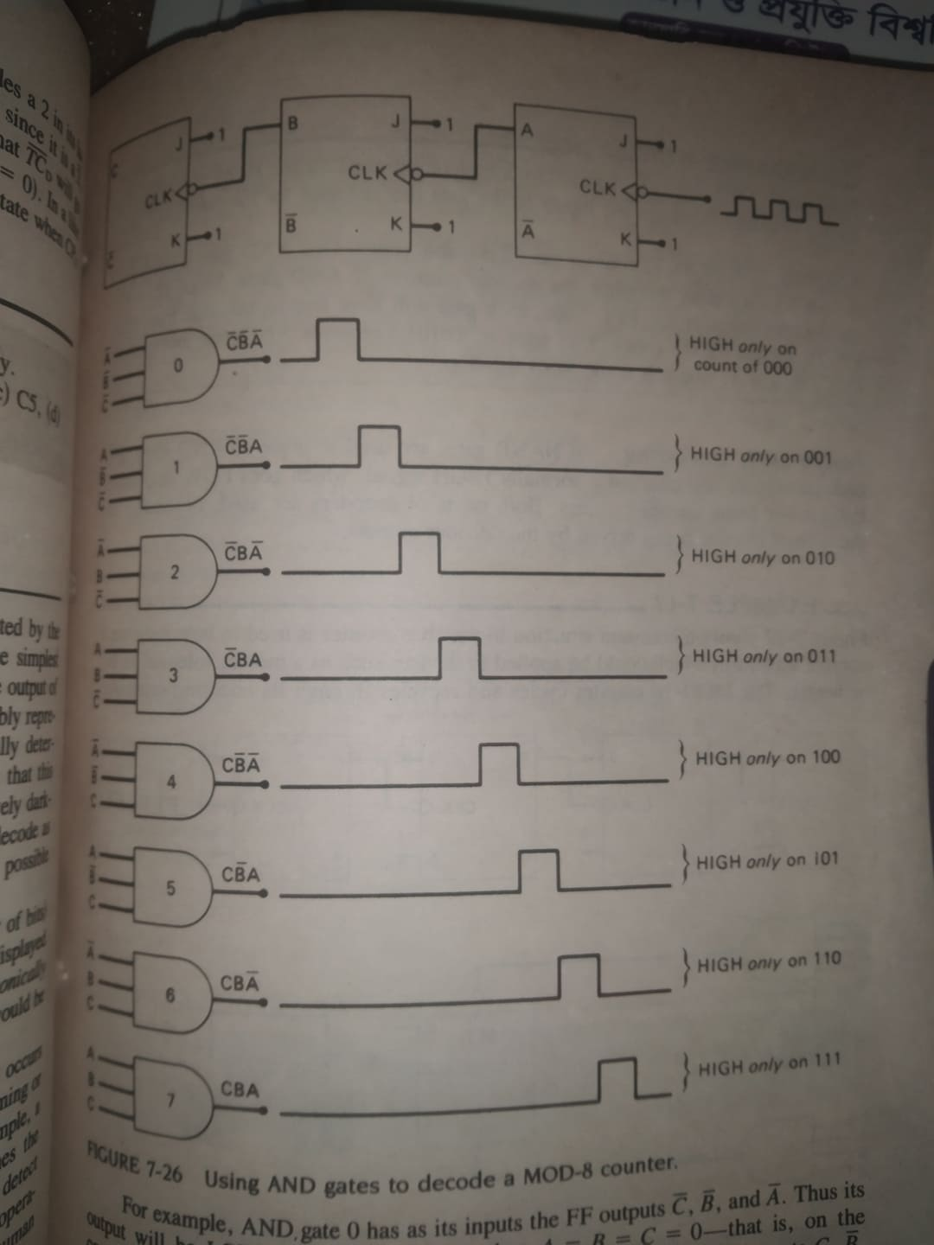
Decoding a mod-8 counter (active High output)

Slide 29
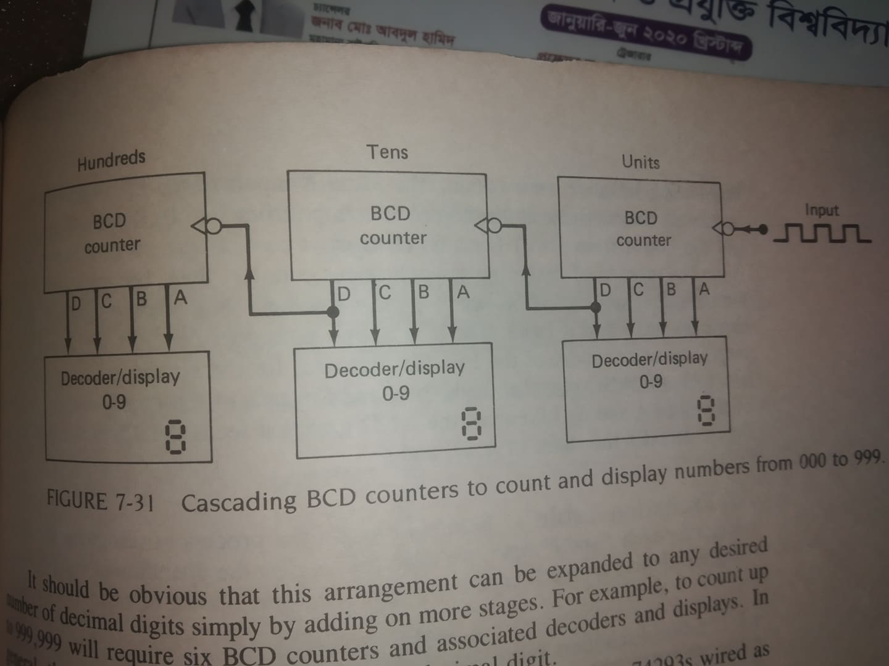
Bcd counter decoding

Slide 30
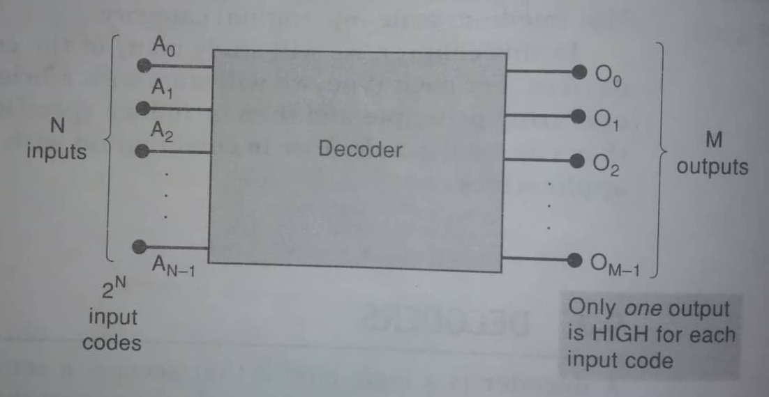
Decoder

Slide 31
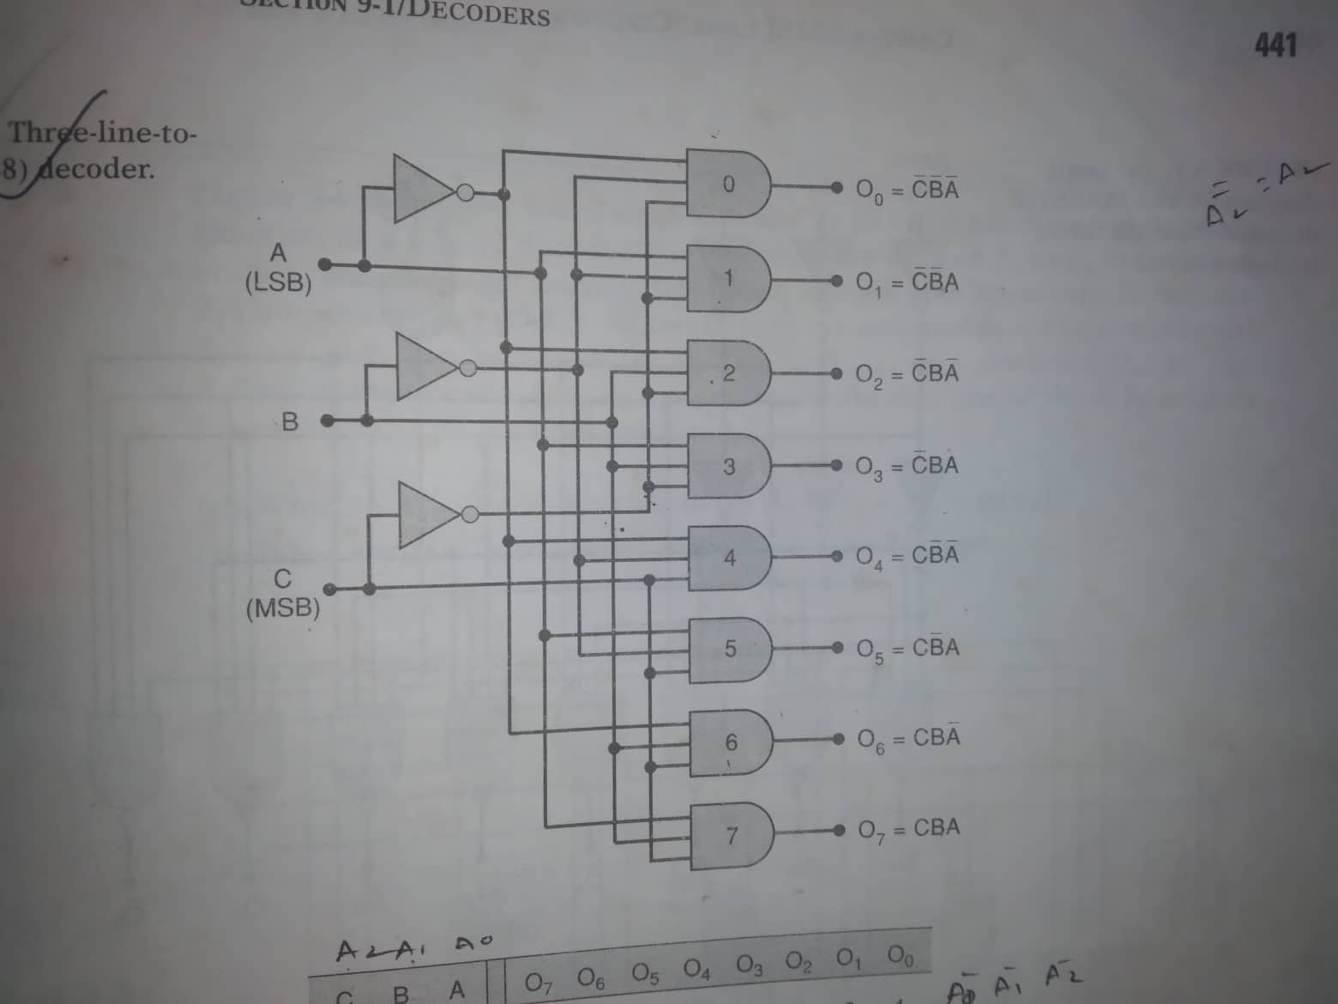
1 of 8 decoder

Slide 32
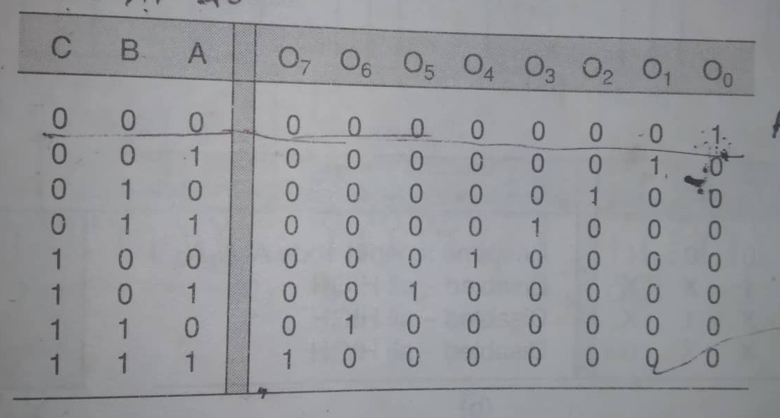
1 of 8 decoder

Slide 33
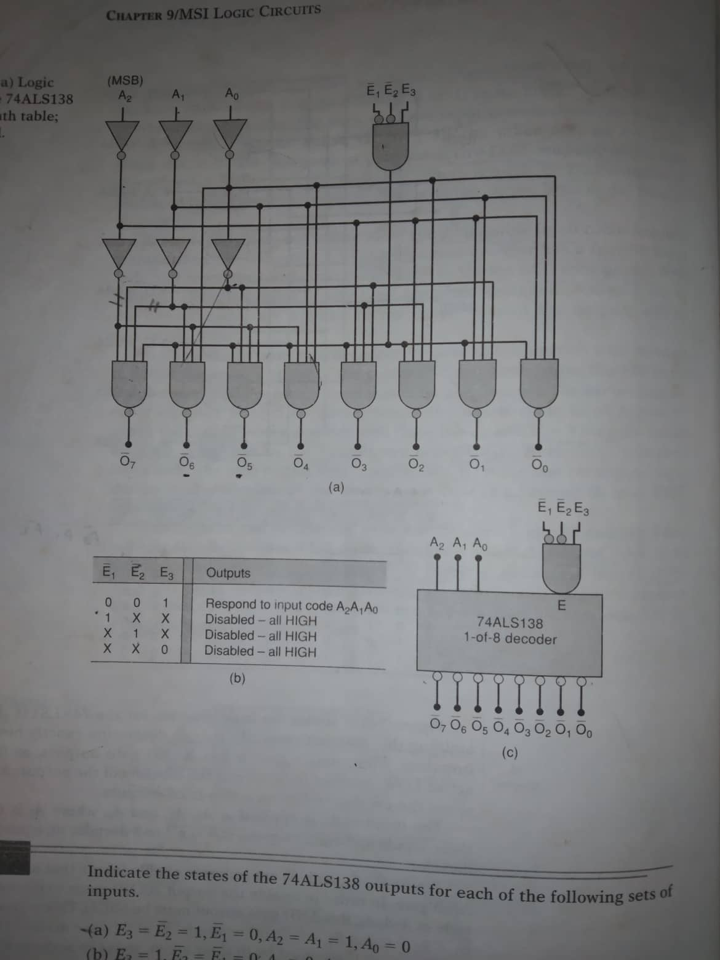
74als138 decoder

Slide 34
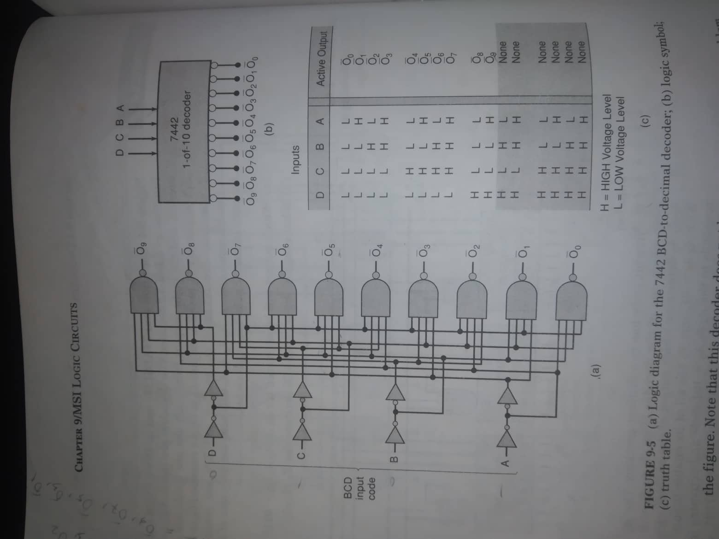
Bcd to decimal
Decoder 7442

Slide 35
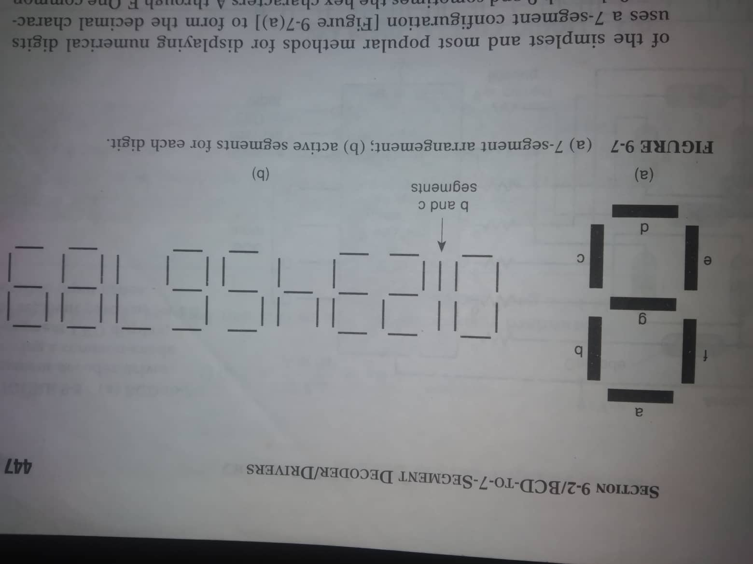
Home work
Bcd to 7 segment decoder/drivers

Slide 36
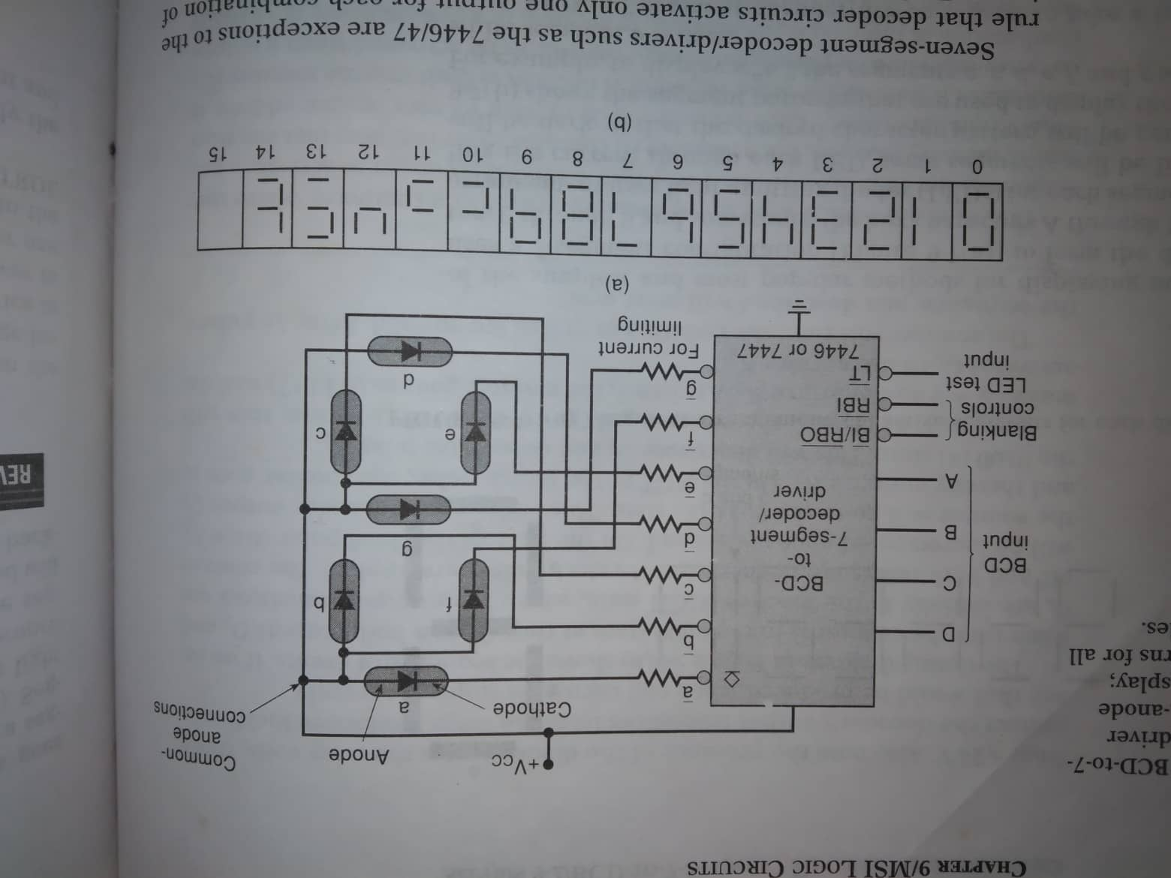
Home work
Bcd to 7 segment decoder/drivers

Slide 37
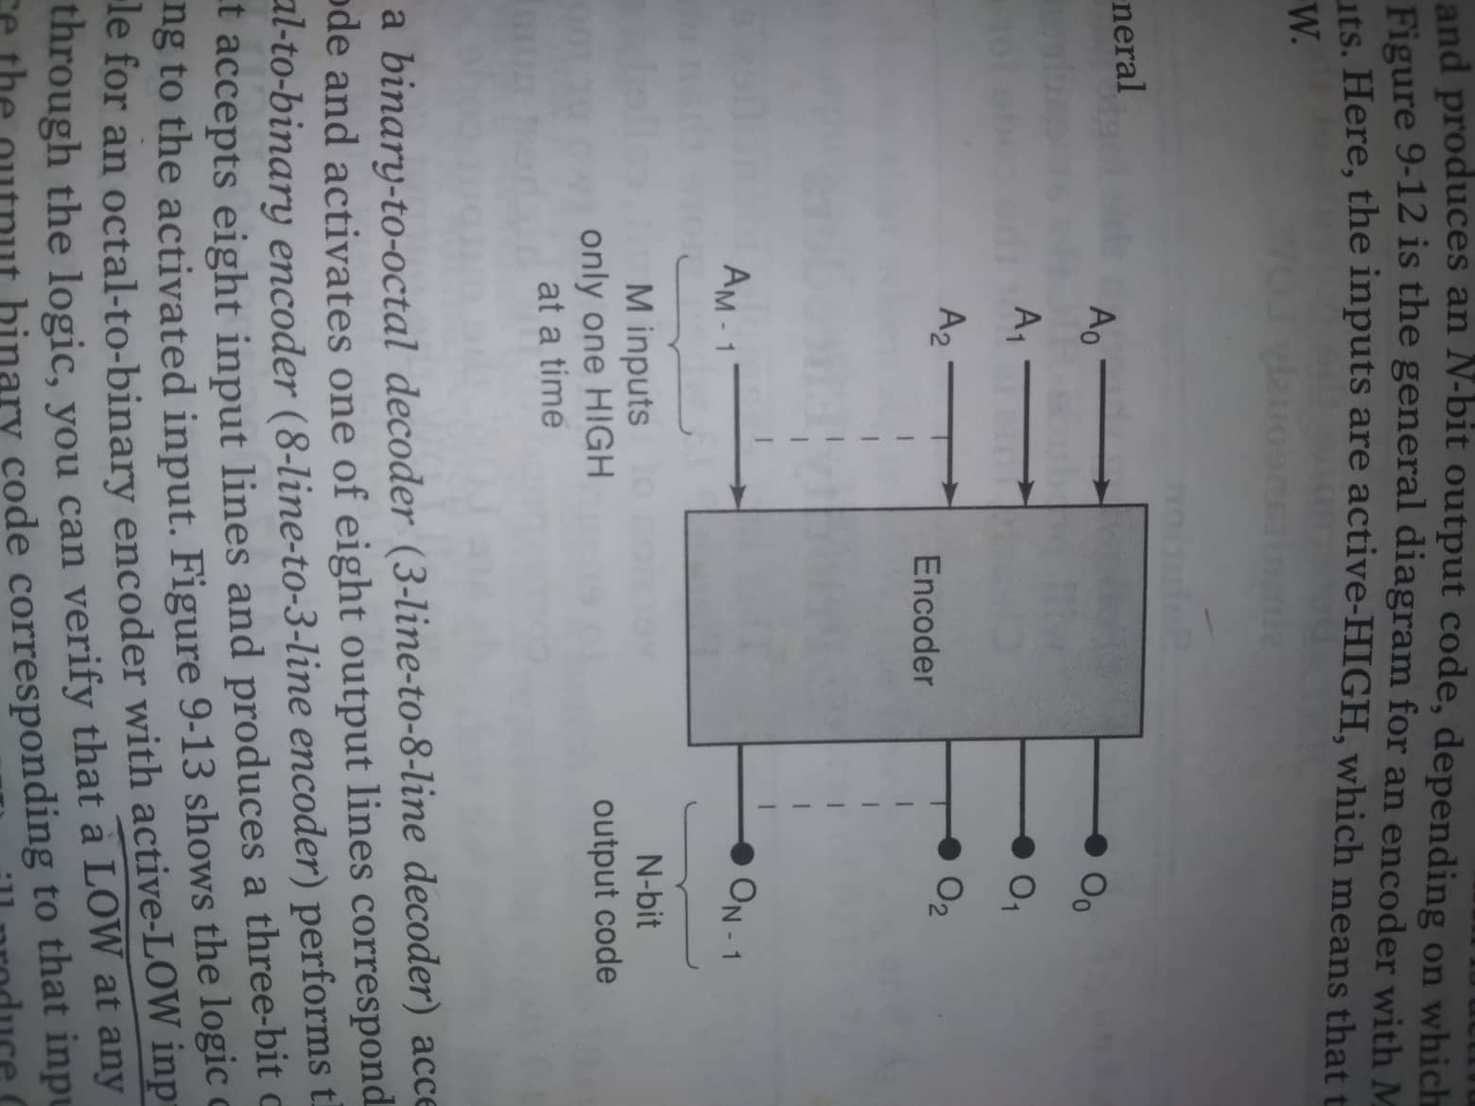
Encoder

Slide 38
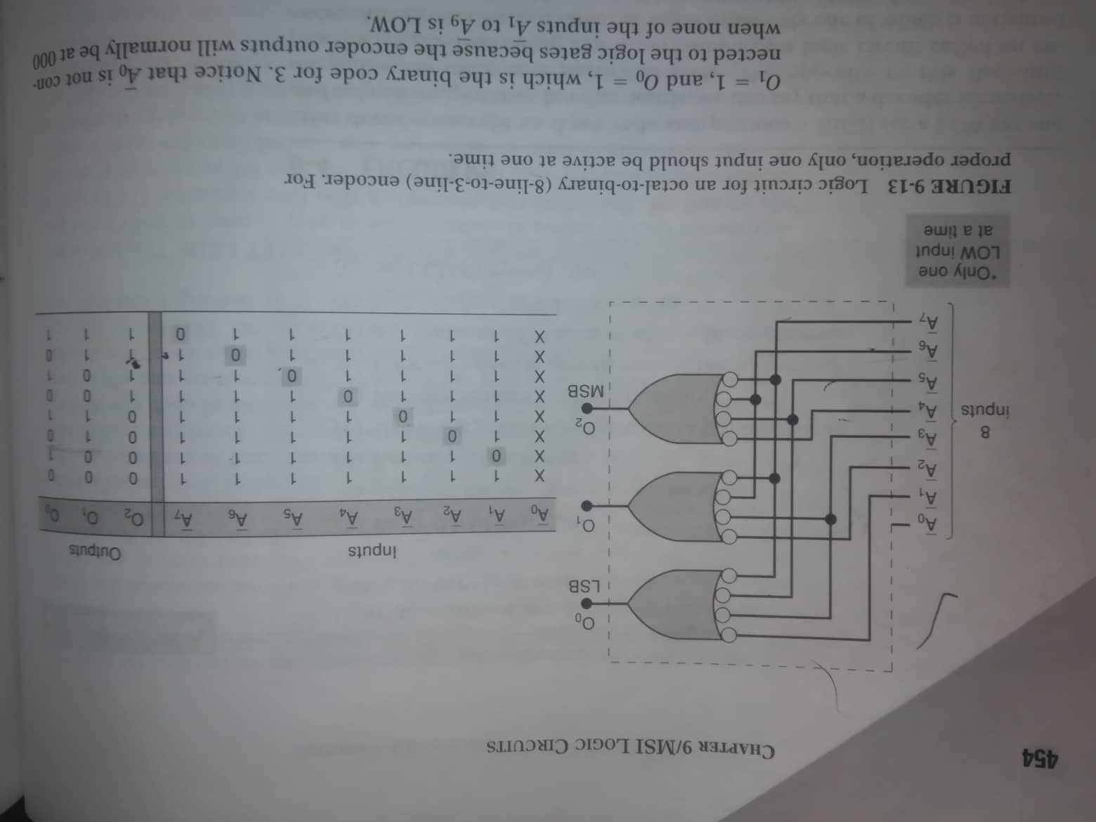
8 line to 3 line encoder

Slide 39
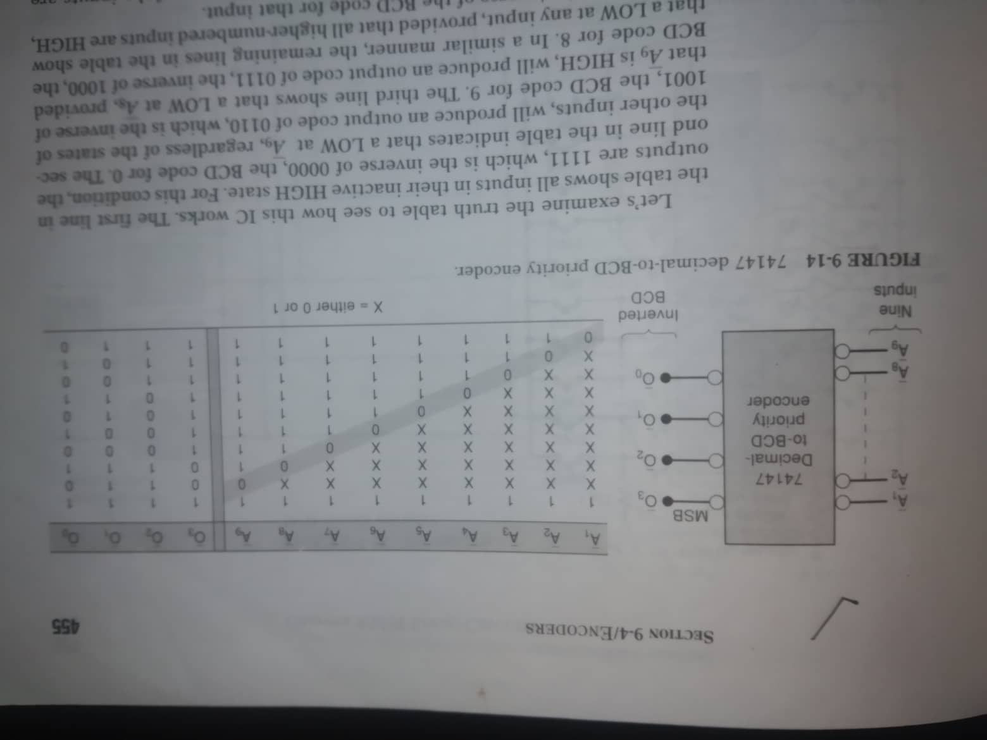
Decimal to bcd priority encoder

Slide 40
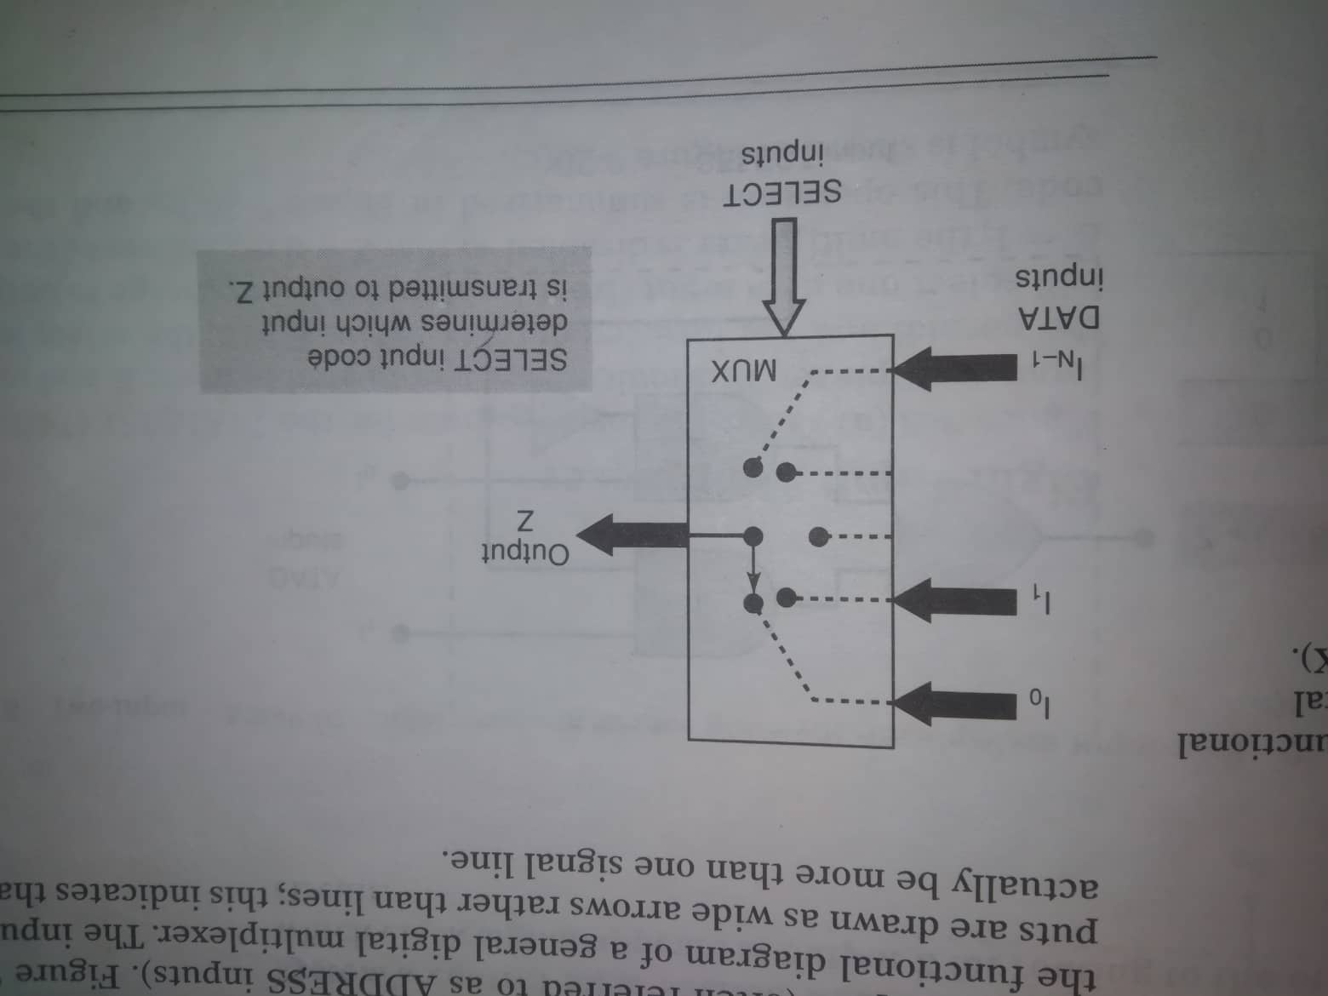
multiplexer

Slide 41
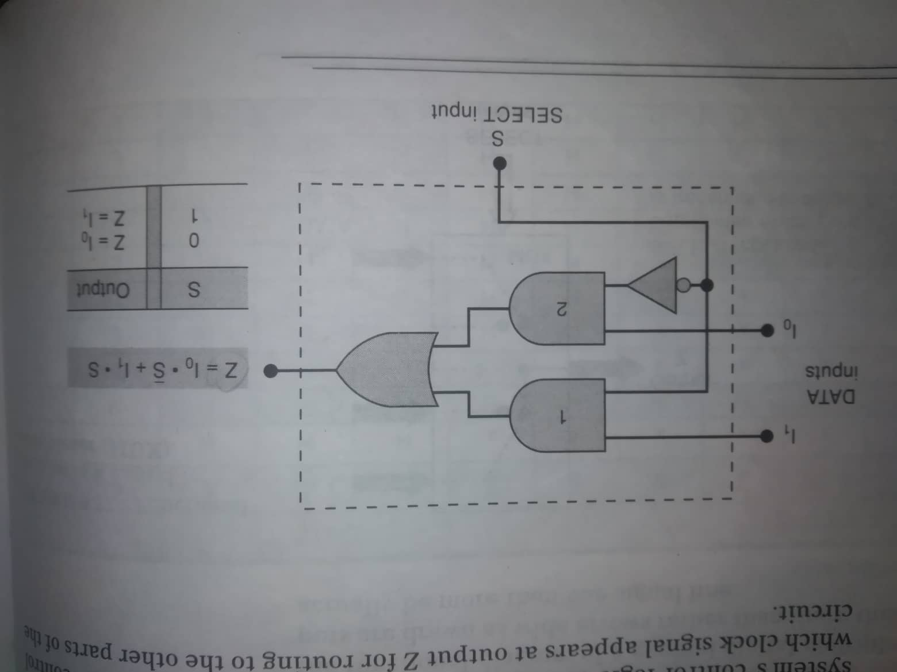
Two input multiplexer

Slide 42
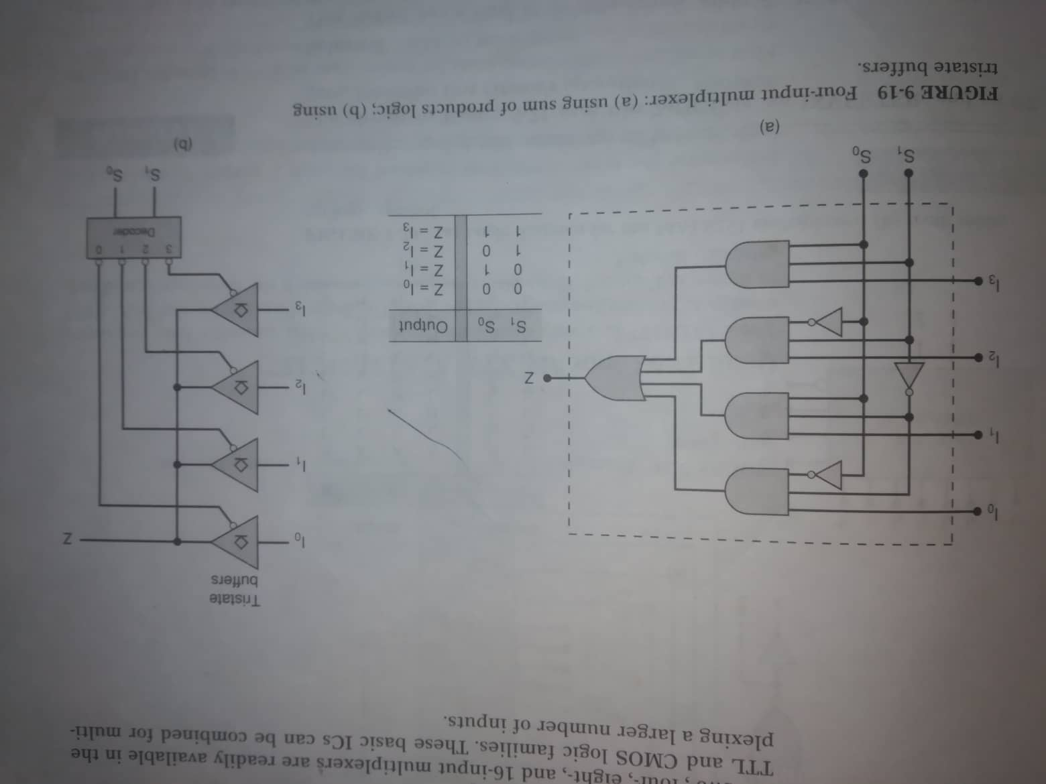
Four input multiplexer

Slide 43
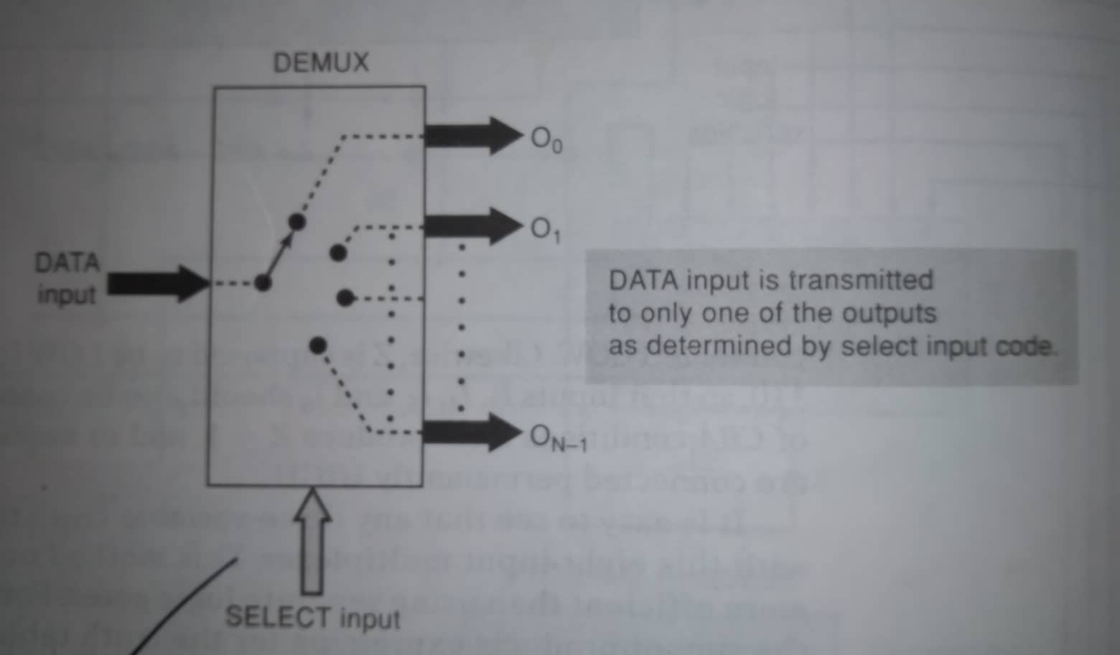
DEmultiplexer

Slide 44
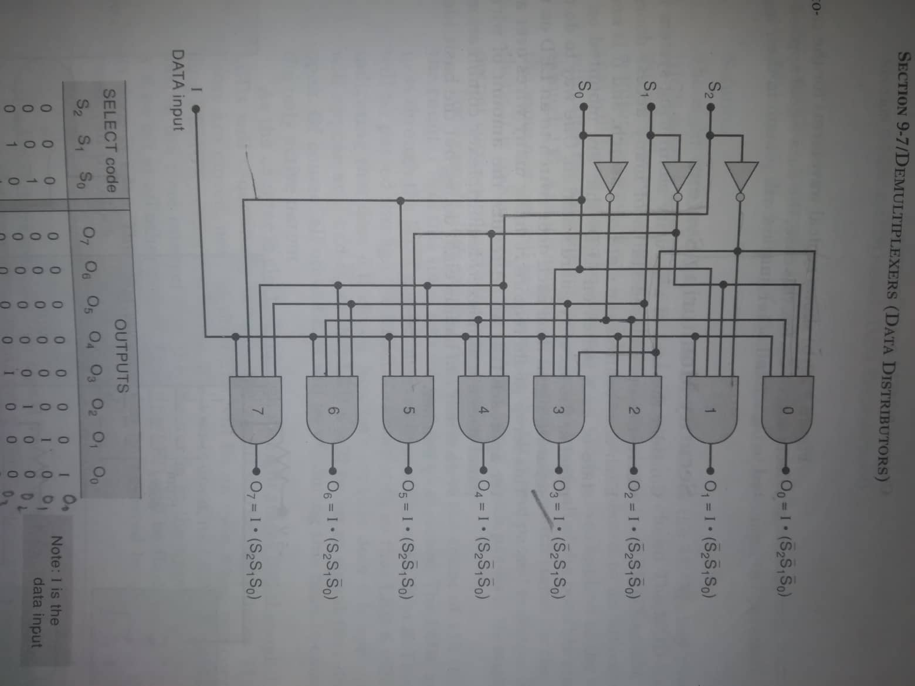
Demultiplexer/ data distributor

Slide 45
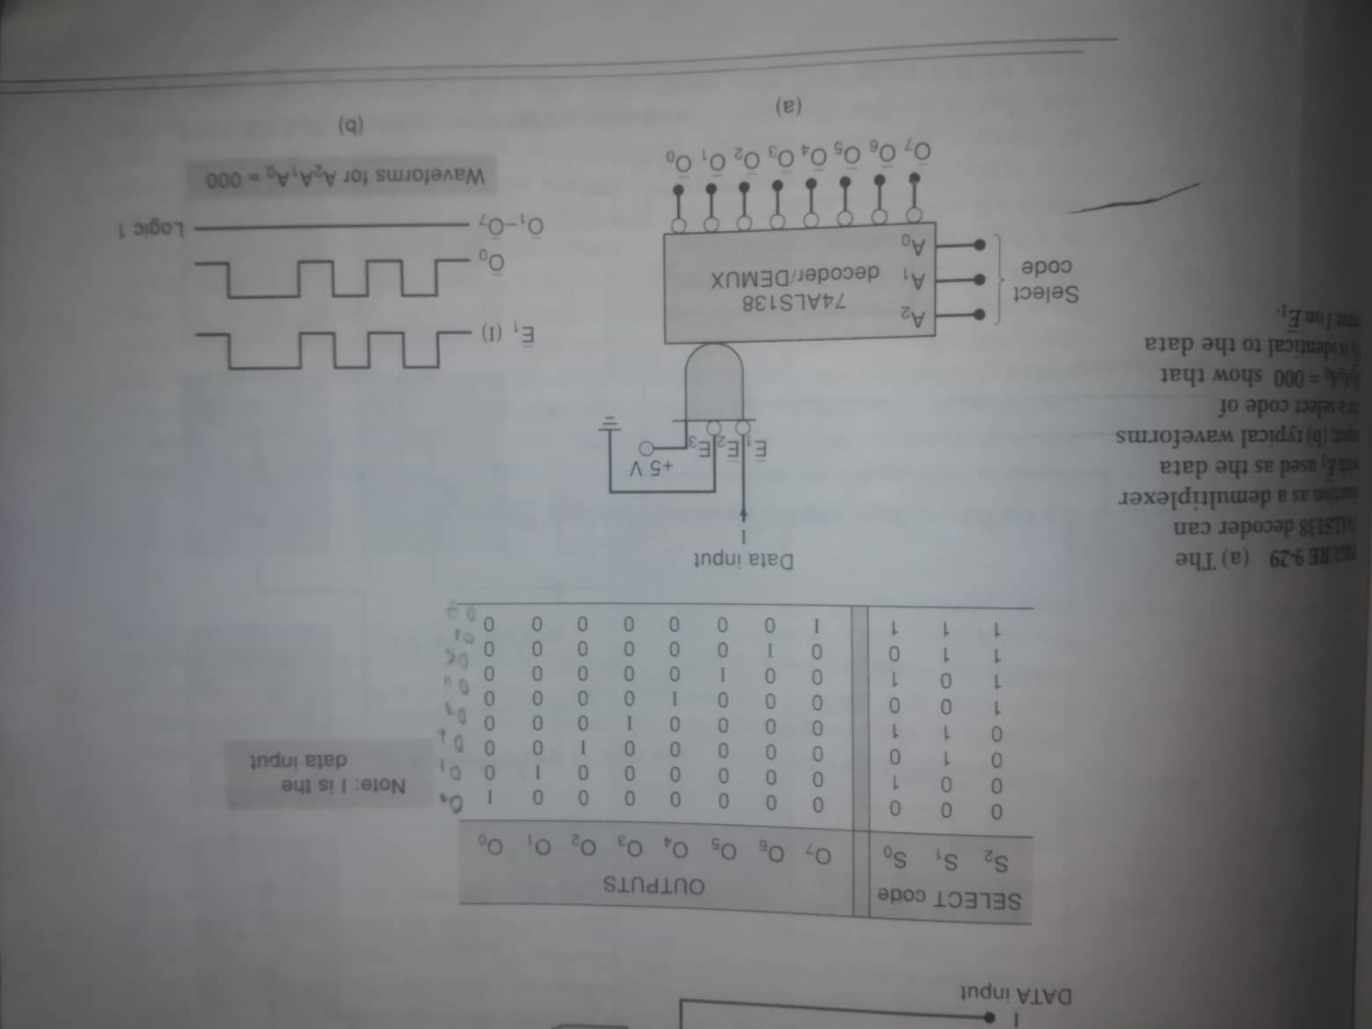
DEmultiplexer

